Slide 1
Stock Market Prediction – 8/6/2021 Progress
Kevin Fitzpatrick, Tessa Karlovitz, Dustin Luchmee

Slide 2
Update - Kevin
Captured news headlines, tweets, and OHLC pricing for TSLA, AMD, NVDA, and GE
Ran sentiment analysis on the headlines and tweets using StanfordNLP’s pre-trained sentiment model
Ran 3 machine learning models:
Logistic Regression
Neural Network
Random Forest
Tried to predict if price would be up or down (classification) over the next X number of days (1, 3, 5, 7, and 10 days)

Slide 3
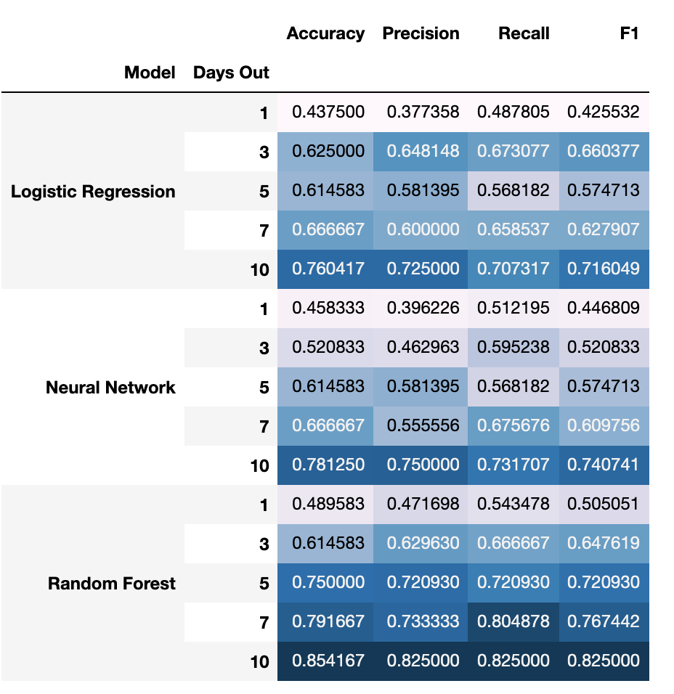
Model Results

Slide 4
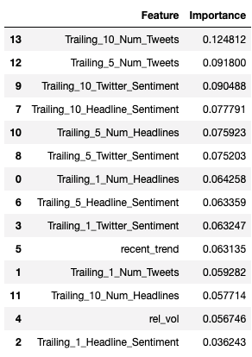
10 Days Out – Feature Importance Ranking For Random Forest

Slide 5
Next Steps
Feature Engineering
Model Tuning

Slide 6
Update - Tessa
First created a TweetString out of our TweetList and applied tokenization to that
Used nltk SentimentAnalyzer to find the polarity score for each tweet in our tweet list
Began by running a linear regression model on those polarity scores
The results below show this did not work very well
Built new predictors based on counts ‘buy’ and ‘sell’
Results were better and described in detail below

Slide 7
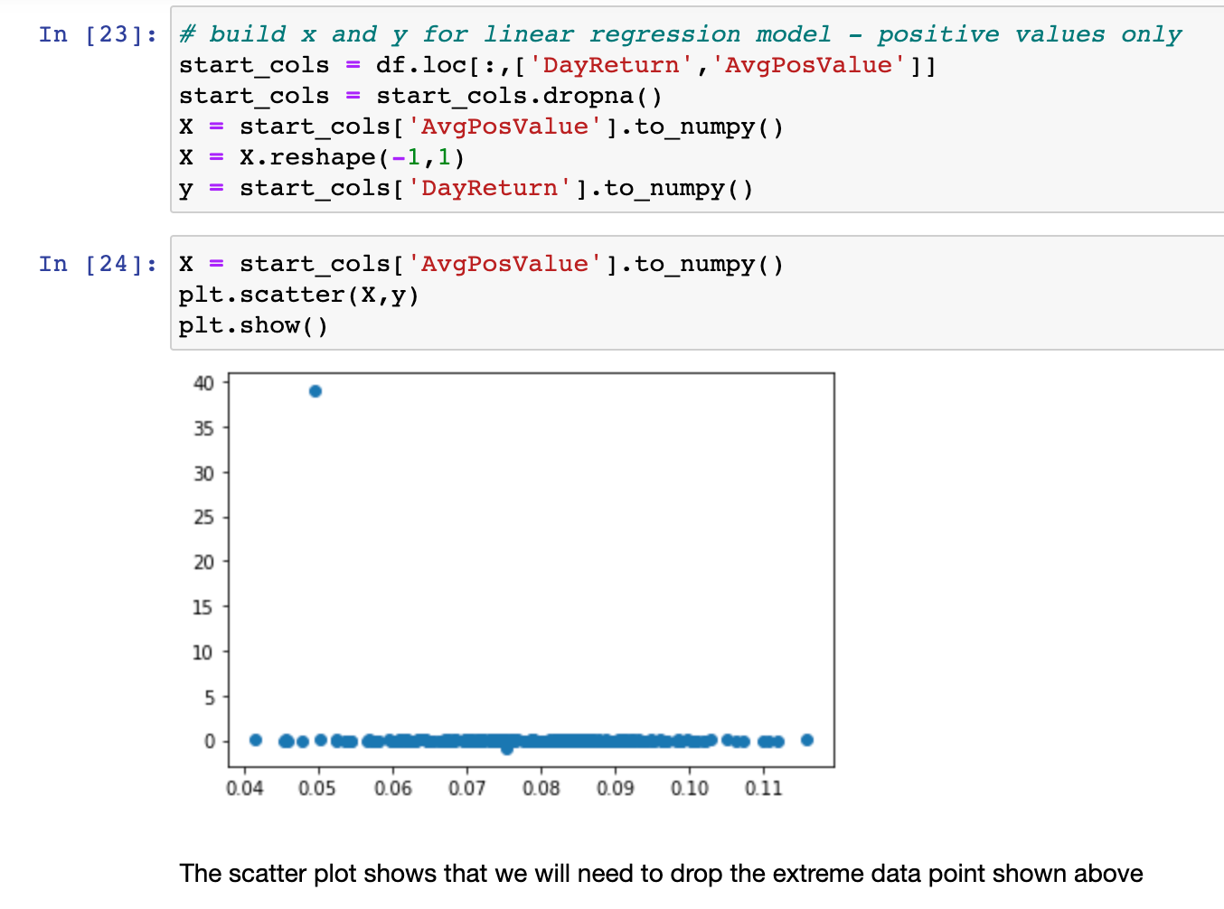
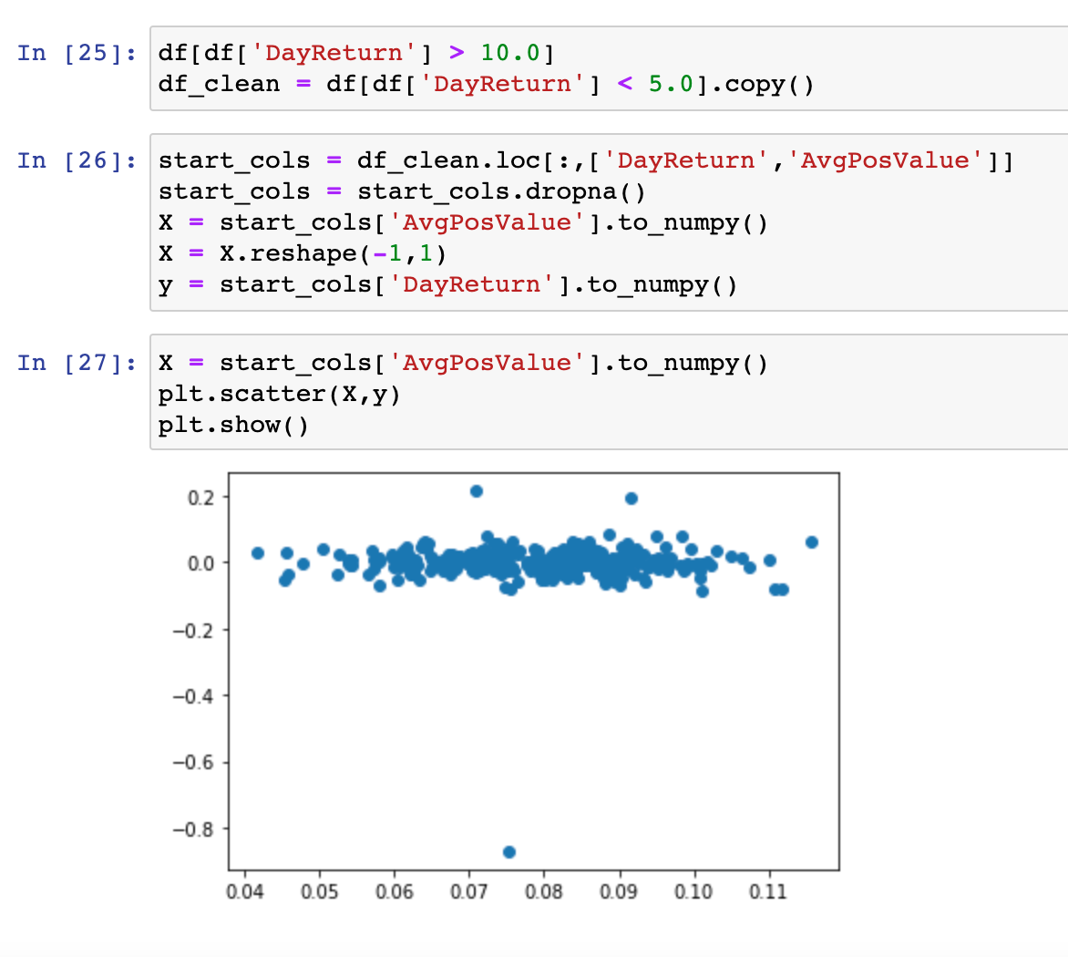
Linear Regression Model Process/Results - Sentiment

Slide 8
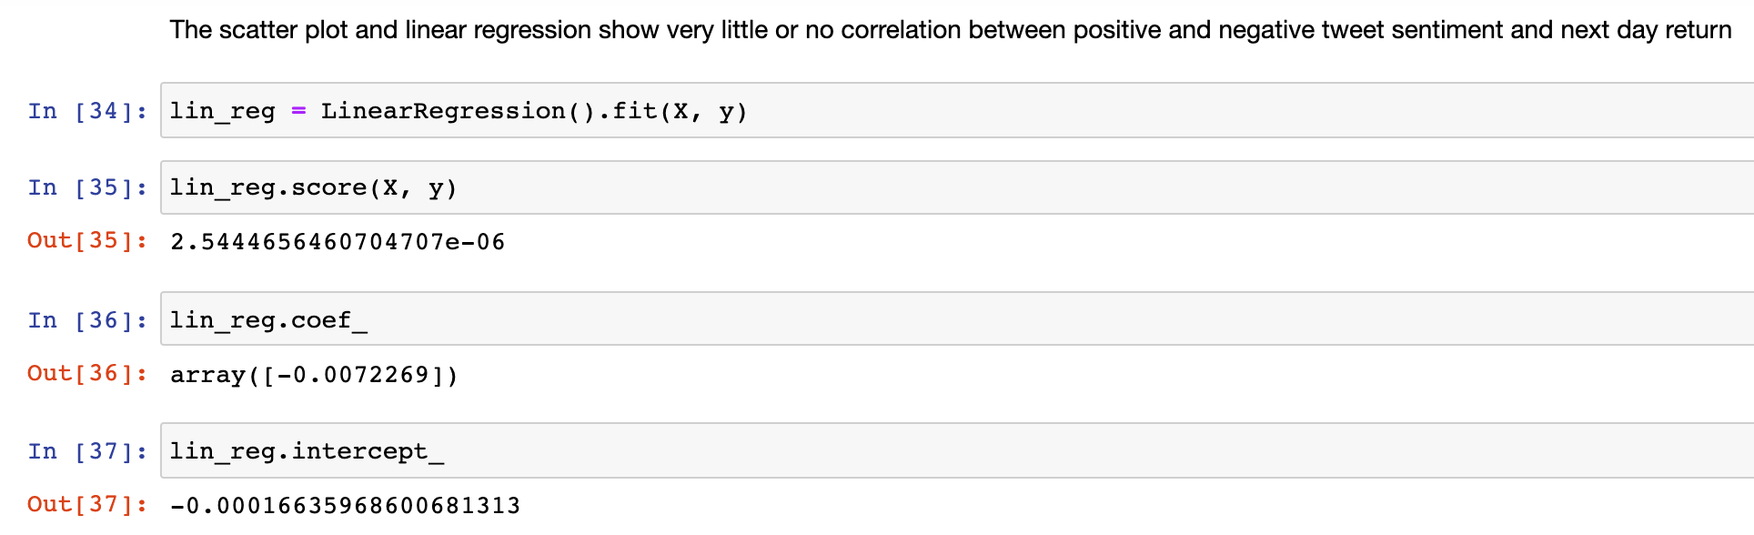
Linear Regression Model Process/Results - Sentiment

Slide 9
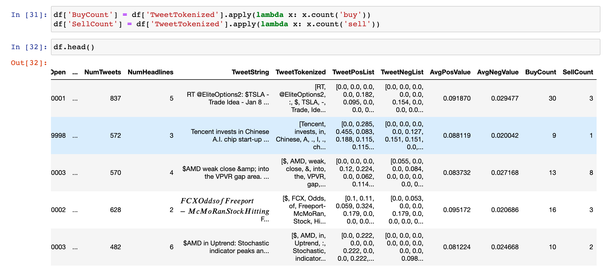
Use ‘Buy’ and ‘Sell’ as Predictors
From the tokenized tweet list I counted the number of times the word ‘buy’ and ‘sell’ appeared and am using that to predict the next day return

Slide 10
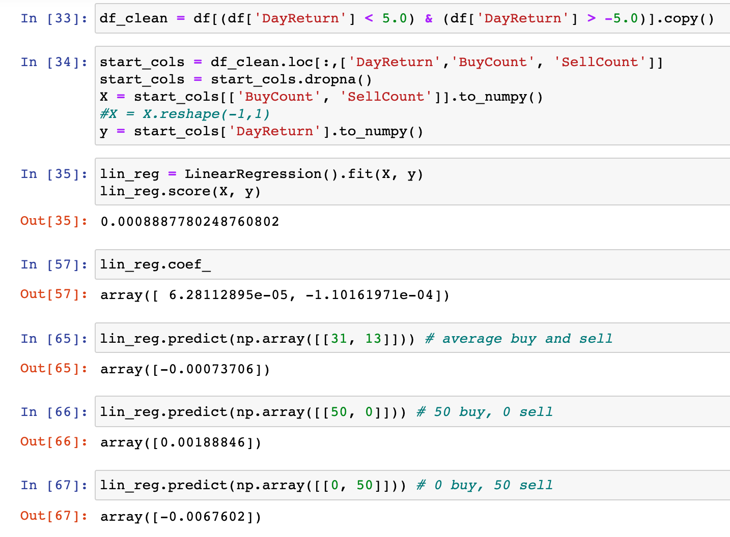
Linear Regression Model Process/Results – Buy and Sell

Slide 11
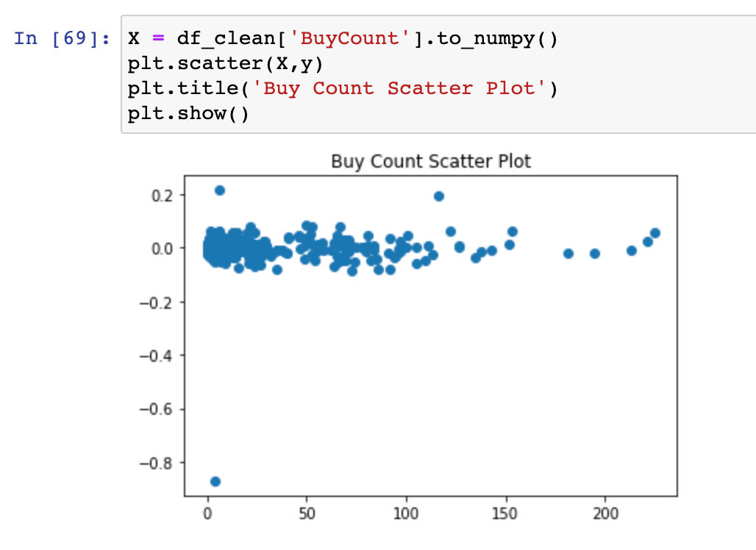
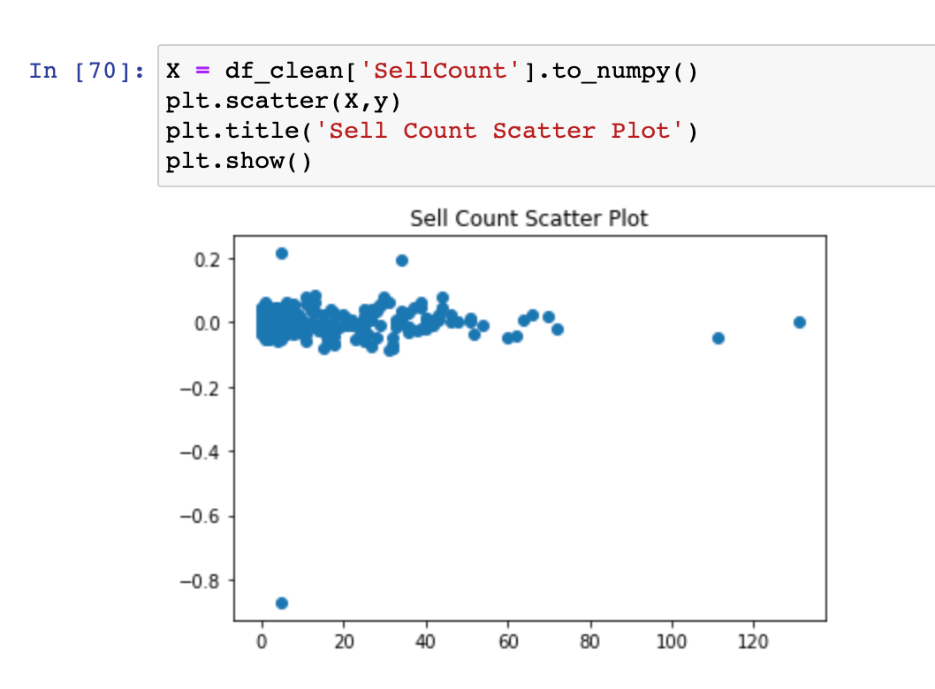
Linear Regression Model Process/Results – Buy and Sell

Slide 12
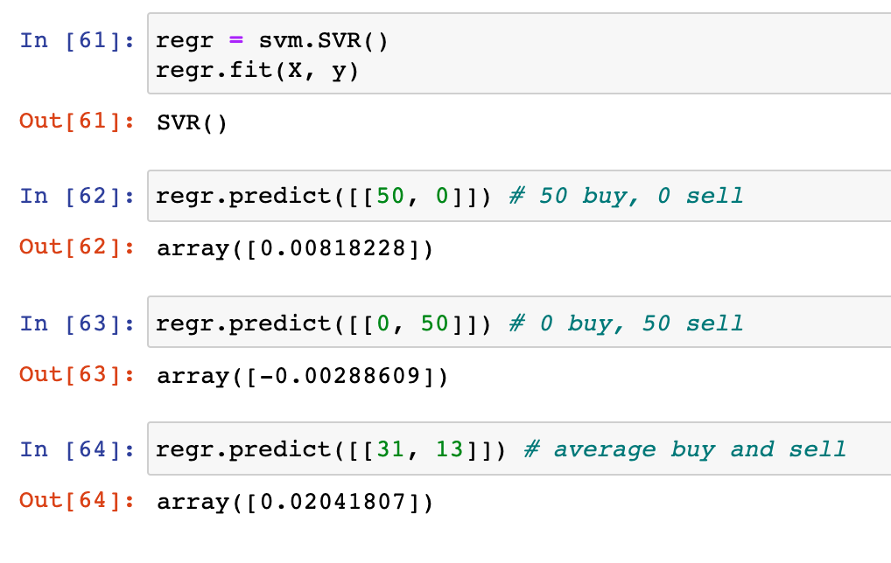
SVM on Buy and Sell

Slide 13
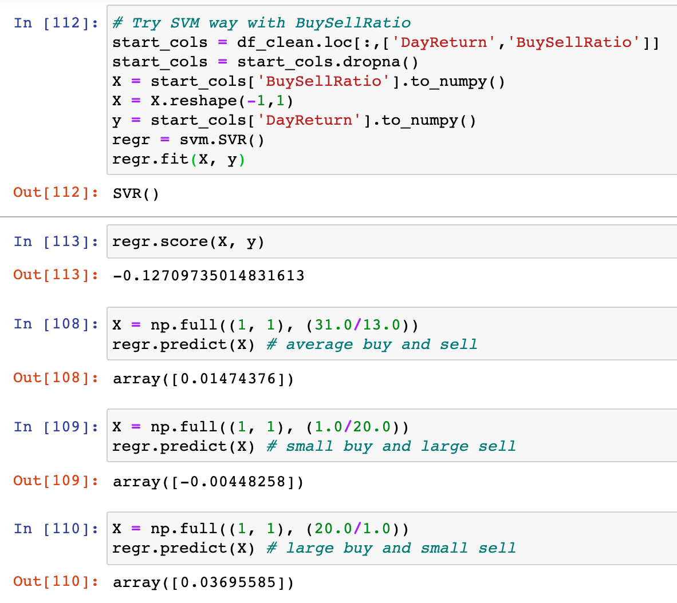
SVM on Buy/Sell Ratio
If we just base this on buy count and sell count separately then it could be confounded on days where there are simply more tweets. By using the ratio we are removing that issue.

Slide 14
Next Steps
More statistics and evaluations to judge the different models
Make a column of predicted returns to compare to the actual returns
Look for other words/phrases that are powerful predictors
‘short squeeze’. Note this is what happened from r/wallstreetbets

